Slide 1
BIOCLERE TREATMENT SYSTEMS
DECENTRALIZED ALTERNATIVE SEWER SYSTEMS

Slide 2
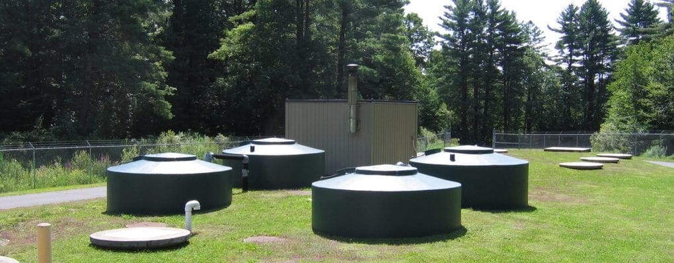
Primary settling tanks

Slide 3
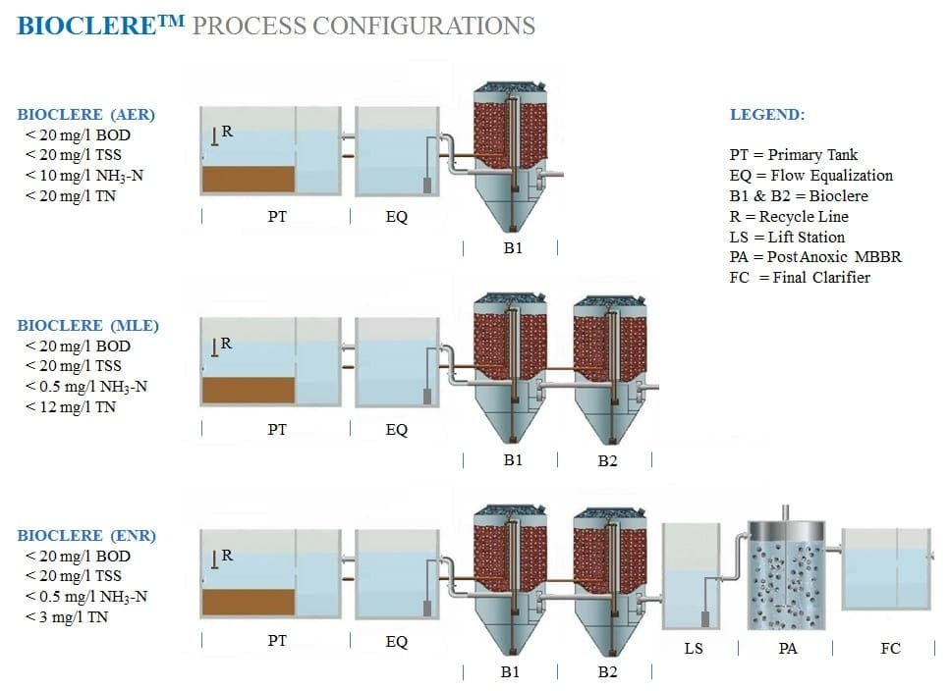

Slide 4
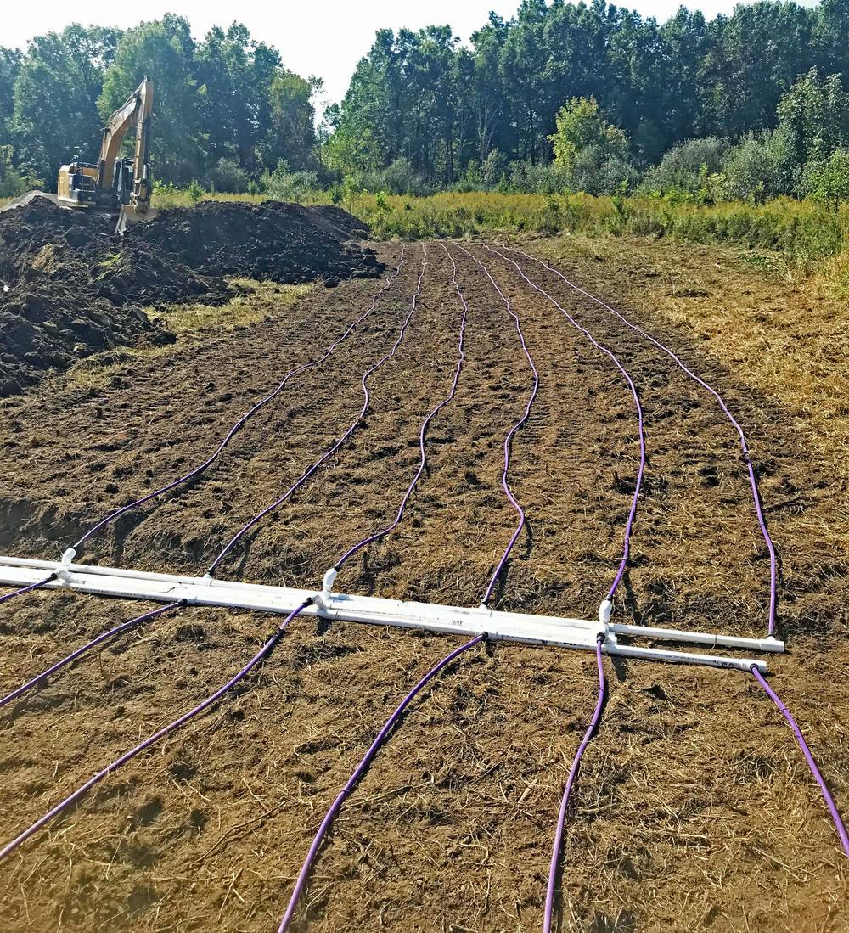
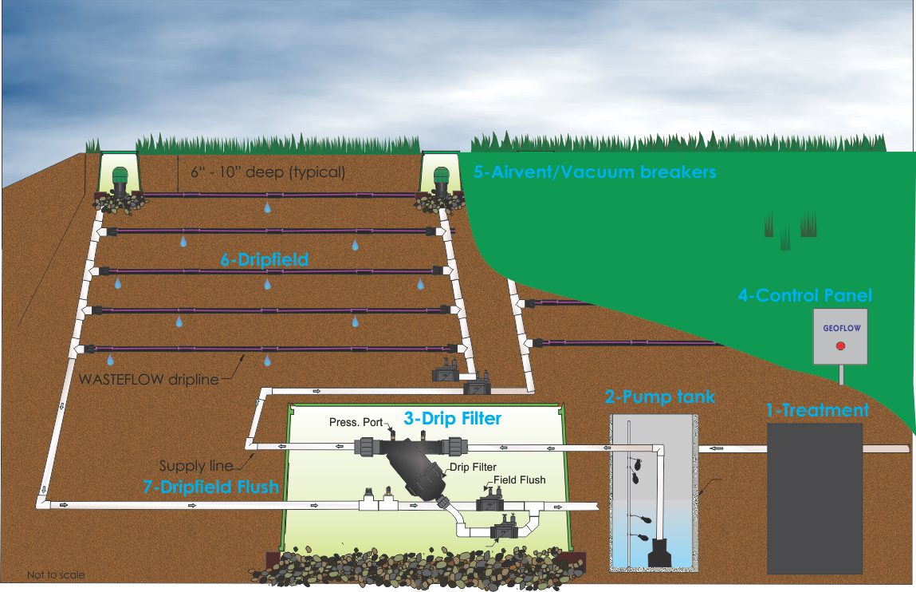
Drip Dispersal Fields

Slide 5
Main System Components
Primary septic/settling tank (buried)
Bioclere fiberglass & PVC treatment unit (partially buried, small vent visible, 50 yr useful life )
Pump/recirculation tank required for flow management
Small Operations Building
Control panels with monitoring and alarms

Slide 6
Operation & Maintenance
Treats up to 20,000 gpd in a single unit
Low maintenance system with periodic inspections
Maintenance performed by a licensed operator
Septic tank requires pumping every several years
Low energy usage (< 1.3 watts / gallon treated)
Produces clean effluent suitable for subsurface dispersal

Slide 7
Site Requirements (General)
Soil must support subsurface dispersal (confirmed by soil scientist)
Exact footprint depends entirely on soil test results
No final design decisions made until testing is complete

Slide 8
Ownership & Permitting
All Systems shall be owned by the City of Spring Hill and permitted through TDEC under the City’s operating permit. Land for drip fields and facility are required to be dedicated to the City of Spring Hill.
Developers shall bear all costs for design, permitting, and construction until dedication and acceptance by the City. Performance and maintence bond requirements from the UDC will apply.
The City will hold and maintain the SOP, and will be the sole operator.

Slide 9
Governance & Approval Sequence
Developer submits a Memorandum of Understanding (MOU) to be reviewed and evaluated by BOMA. BOMA shall approve or disapprove in a public meeting.
Upon City approval, the Developer’s engineer submits design documents to TDEC for SOP issuance in the City’s name.
System plans must receive written approval from:
GM of Spring Hill Water
City Wastewater Operator
TDEC Division of Water Resources
4. No applications to Planning Commission will be accepted without a BOMA approved MOU.

Slide 10
System Overview
Wastewater shall be collected via gravity or small-diameter pressure mains to a centralized Bioclere treatment facility.
Treated effluent shall discharge to a shared drip or subsurface disposal field.
No individual septic or STEP tanks are permitted on residential lots.

Slide 11
Design Flow
250 gallons per day (gpd) per Equivalent Dwelling Unit (EDU).
Design must include 100% of design flow for the primary field and 50% reserve field area.

Slide 12
Site and Soil Evaluation
Soil Scientist Requirements
  Evaluation and certification by a Tennessee-licensed soil scientist required.
Minimum of two borings per acre (minimum four per field), to a depth of 6 ft or to refusal/water table
Report must document texture, structure, permeability class, and depth to limiting layer.

Slide 13
Soil Suitability & Loading Rates
Soil Texture | Depth to Limiting Layer | Max Hydraulic Loading (gpd/ft²)
Sandy loam / loam | >48 in | 0.30
Silt loam | 36–48 in | 0.20
Clay loam | >48 in | 0.10
Sandy clay / heavy clay | <36 in | Unsuitable

Slide 14
Reserve Area
Reserve area must be ≥ 50% of primary field.
Must contain equal or superior soils.
Shall be platted, fenced, and marked: “Reserved for Future Disposal Use – No Construction or Grading.”

Slide 15
Treatment System Design Standards (Bioclere or Equivalent)
Component | Requirement
System Type | Fixed-film biological treatment (Bioclere or equivalent) with clarifier, recirculation, and disinfection.
Pretreatment | Influent screening (2–3 mm) before Bioclere unit; EQ basin sized for 4 hrs peak flow.
Hydraulic Loading | Per manufacturer’s certified data and TDEC approval; redundancy for ≥ 1 day avg. flow.
Recirculation Ratio | 3:1 to 5:1 minimum.
Disinfection | UV or tablet chlorination; include sampling port.
Performance Standard | Effluent ≤ 30 mg/L BOD, ≤ 30 mg/L TSS, and ≤ 10 mg/L NH₃-N (if required).

Slide 16
Effluent Disposal System
Type: Subsurface drip or shallow pressure-dosed trenches.
Depth to Limiting Layer: ≥24 in (36 in preferred).
Design Flow Basis: 100% of design flow at verified HLR.
Field Construction:
Trenches 18–24 in deep, 2 ft wide, 6 ft on center spacing.
Drip tubing: 1/2–1 in diameter, emitters @ 24 in spacing.
Pressure test: 100 psi for 15 min, no leakage.
Reserve Field: Fully cleared and ready for future activation.

Slide 17
Site Setbacks and Buffers
Feature | Minimum Distance (ft)
Residential structure | 200
Property line | 50
Potable well | 100
Water/storm main | 10
Stream, sinkhole, or drainage way | 100
Disposal field to Bioclere plant | 50

Slide 18
Construction & Inspection
Pre-Construction Meeting required with City Engineer and Inspector.
Inspection Points:
Bioclere structure excavation/foundation
Pipe bedding and testing
Drip field installation
Control panels/electrical
System startup and demonstration
Record Drawings: GPS coordinates of all components (±1 ft accuracy).
As-Built Plans: Must be signed and sealed, matching SOP conditions.

Slide 19
Operations & Maintenance
Operator: Licensed wastewater operator (Class II minimum).
Sampling: Monthly BOD, TSS, TN per TDEC SOP.
Maintenance: Quarterly cleaning of filters, pumps, and blowers.
SCADA/Telemetry: Recommended for systems >10,000 gpd.

Slide 20
Easements, Dedication, & Financial Assurances
System Parcel: Dedicated to City at or before first final plat.
Access Easement: 20 ft minimum from ROW to plant and field.
Performance Bond: Per UDC Requirements
Maintenance Bond: Per UDC Requirements
Insurance: Maintained by Developer until City acceptance.

Slide 21
Submittal Requirements for MOU Approval
1. Concept Plan & MOU Application
2. Soils Evaluation Report (Licensed Soil Scientist)
3. Engineering Design Report (flows, HLR, headloss)
4. Construction Drawings (sealed, with easements)
5. TDEC SOP Application (City as applicant)
6. Operation & Maintenance Manual
7. As-Built Drawings and Certifications

